Slide 1

Jordon Frye
Korbin Clark
Dan Kilcullen
Scott Emmons

Slide 2
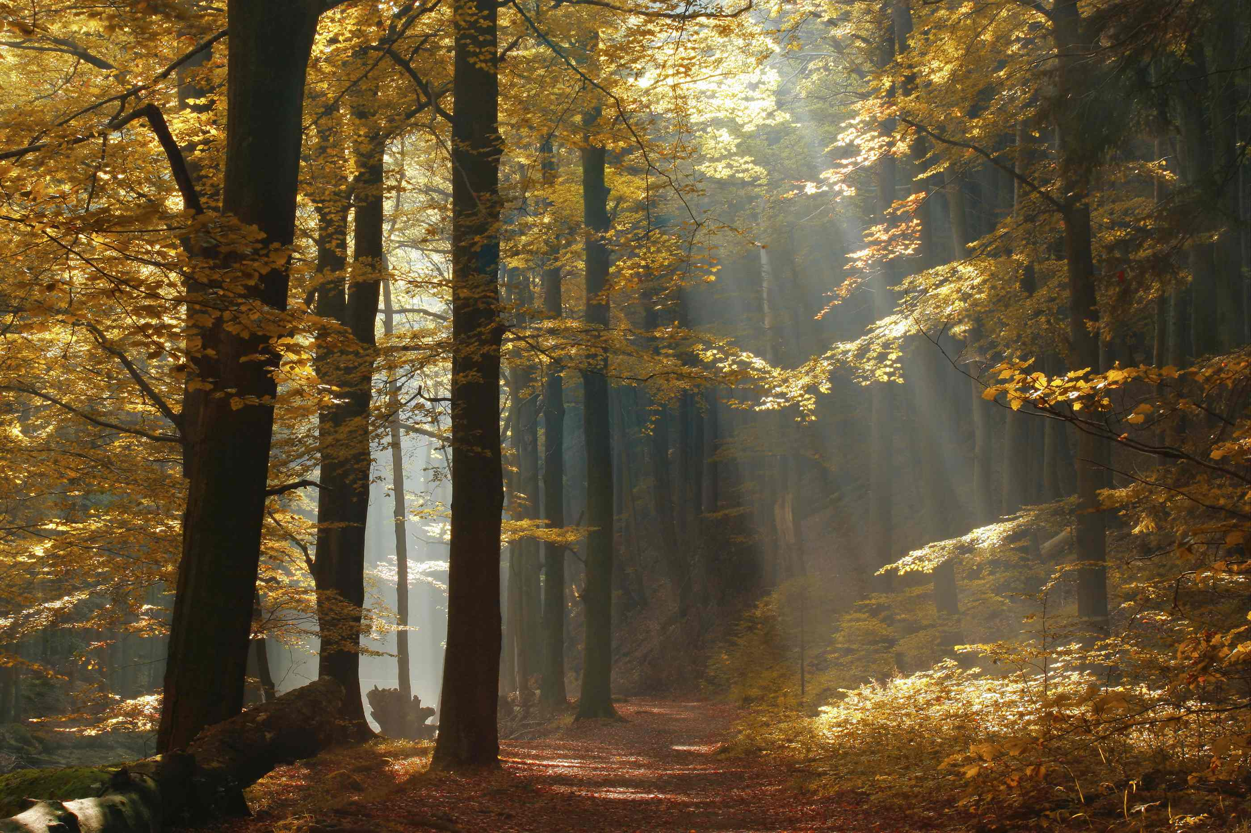
Two roads diverged in a wood, and I-
I took the one less traveled by,
And that has made all the difference.
Frost, Robert. Mountain Interval. New York: Henry Holt and Company, 1920; Bartleby.com, 1999. January 7, 2013.

Slide 3
The Scenario
Smith Sporting Goods
Wishes to operate for 5 more years

Slide 4


The Problem
Current inventory is haphazard
Marketing is unfocused
Buyer power
Have better prices
More options

Slide 5
The Problem
The Solution
Buyer power
Have better prices
More options
Current inventory is haphazard
Marketing is unfocused

Slide 6
The Solution
Mr. Smith must
Specialize
Find his niche
Higher profit margins
Focus marketing to
Demographics

Slide 7
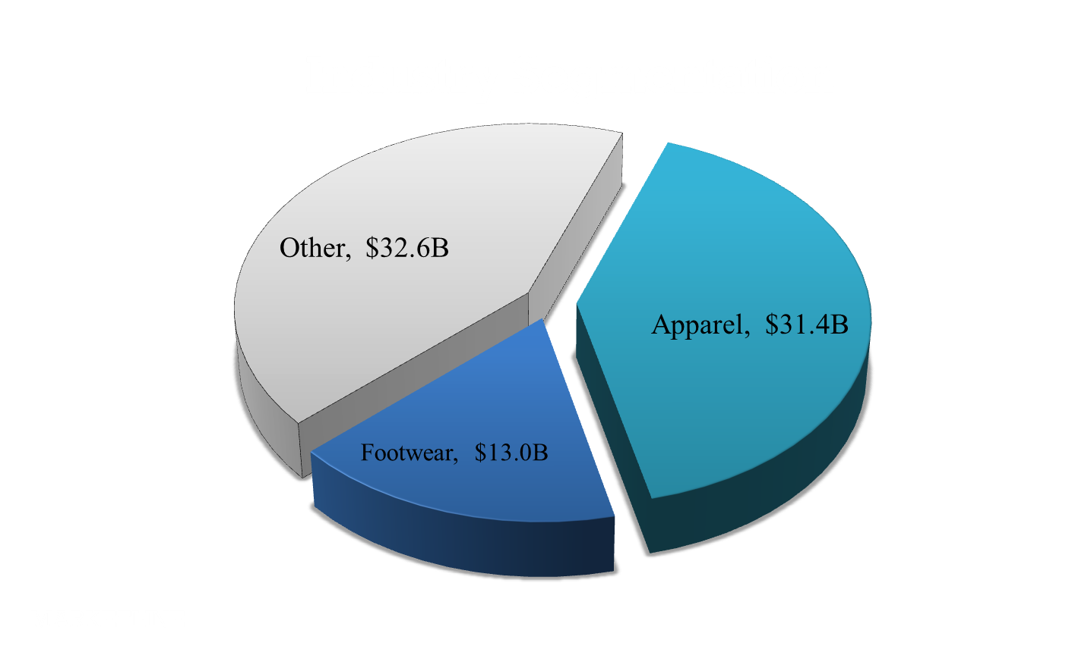
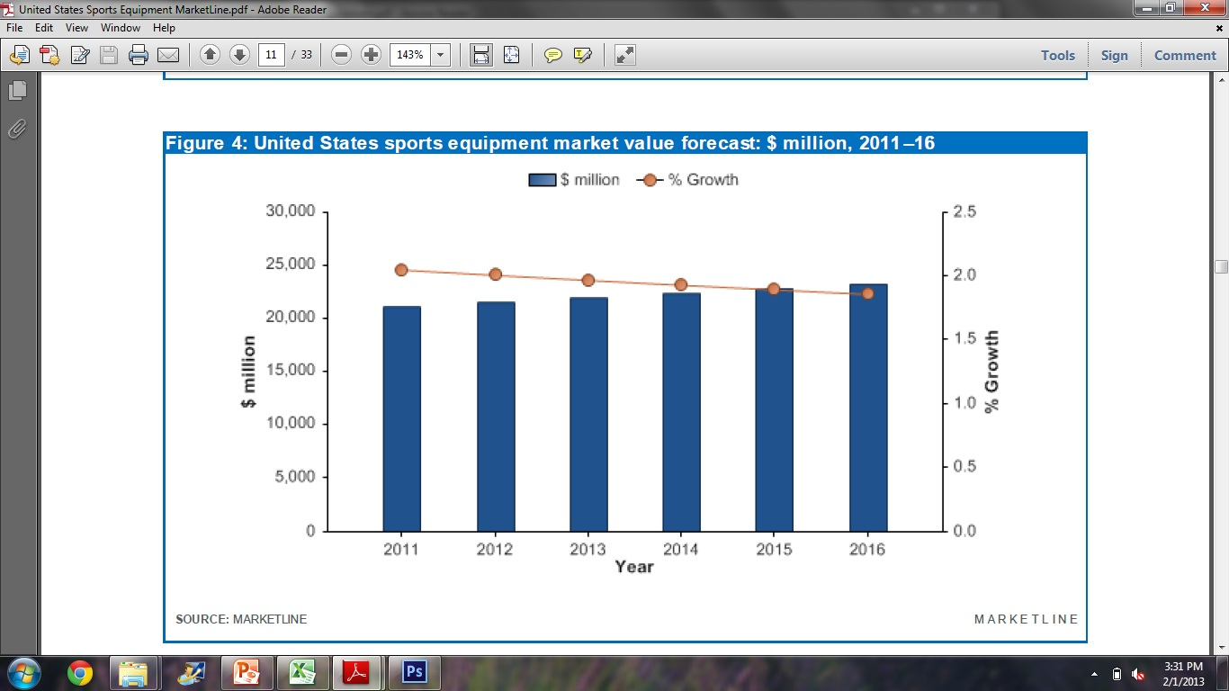
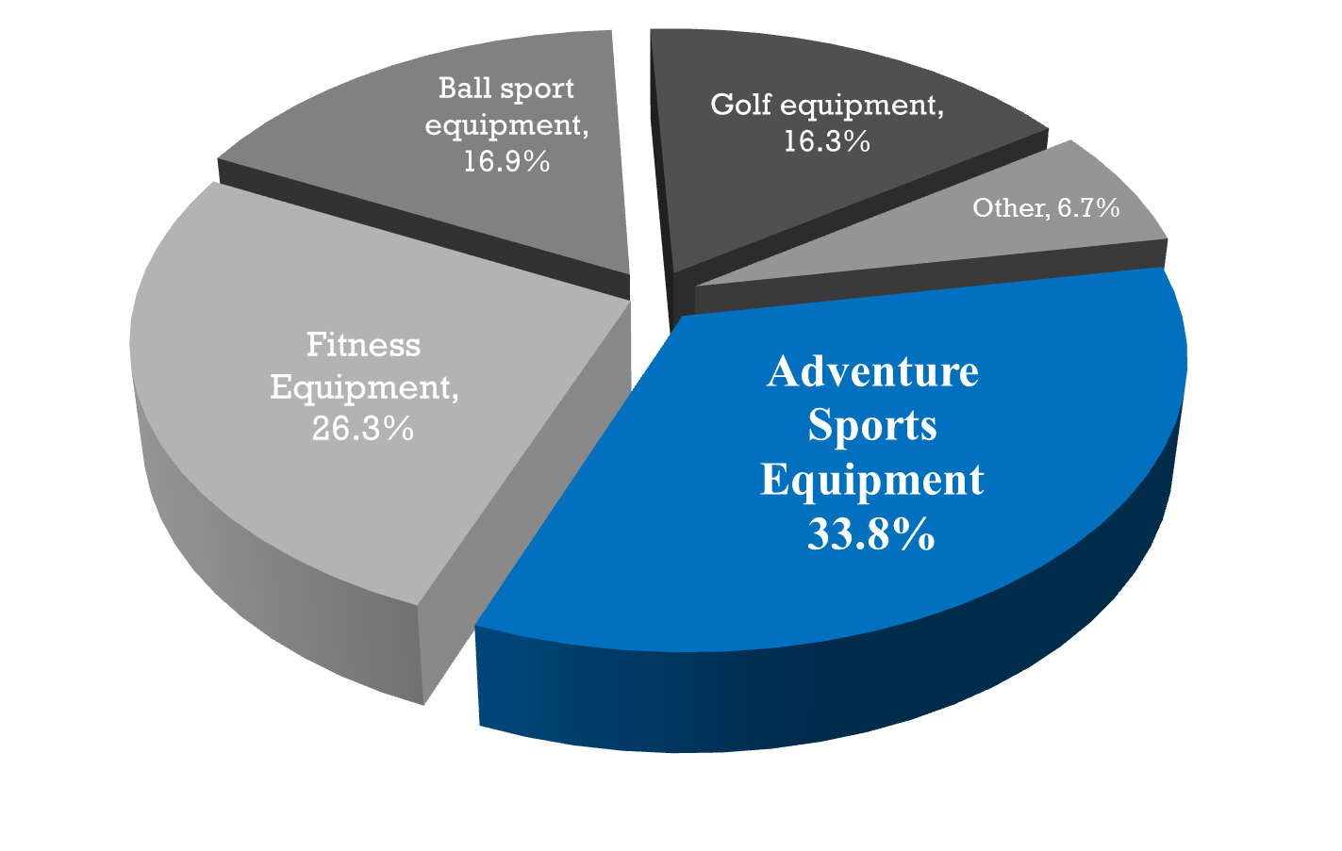
Market Research
Industry Sectors
MARKETLINE

Slide 8
The sporting goods industry grew 4.2% in 2011¹
$77 billion in wholesales¹
Apparel sales and athletic footwear account for over half of the industry¹
Apparel: $31.4 billion in 2011, up 3.4% from 2010¹
Footwear: $13 billion in 2011, up 4.5% from 2010¹
Adventure sports equipment leading industry sector at 33.8% in sales²
First Research Industry Profile Quarterly Update “Sporting Goods”
MarketLine “United States – Sports Equipment”

Slide 9
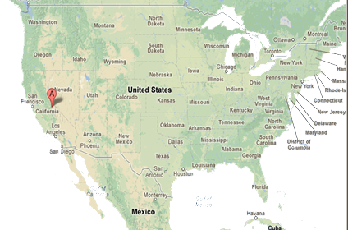
Location

Slide 10
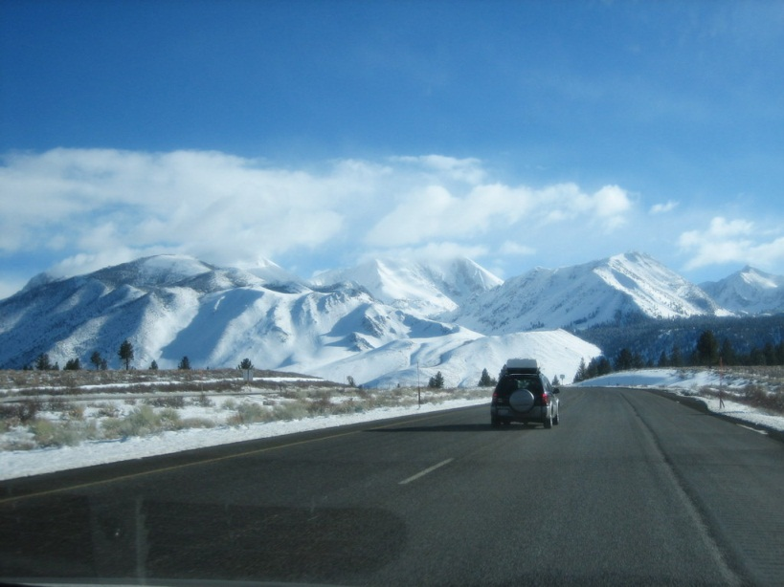
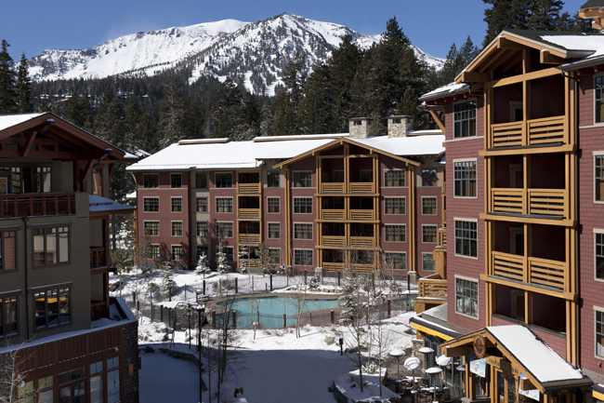
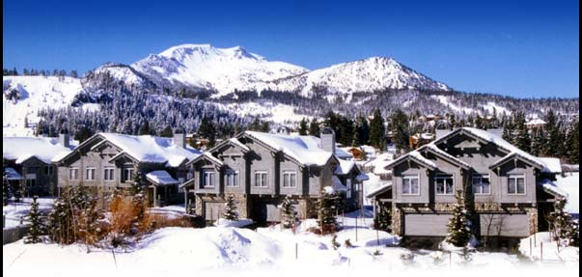
Location

Slide 11
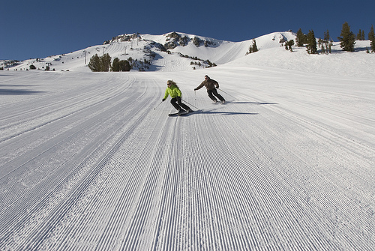
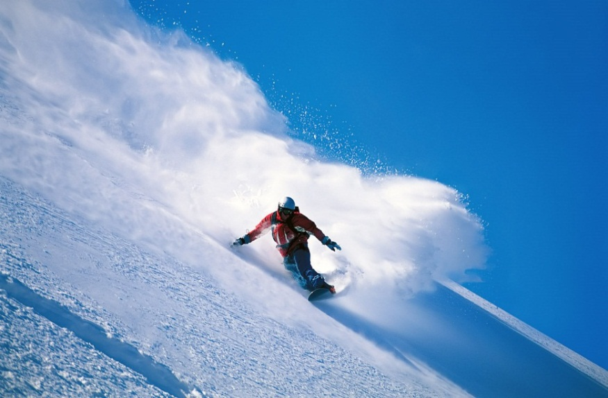
Demographics
The Young
“Adrenaline Junkies”
“Outdoor Enthusiasts”
Almost half of all households single men/women
Government of Mammoth Lakes, CA Factsheet

Slide 12

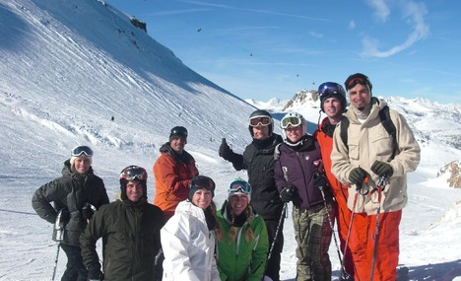
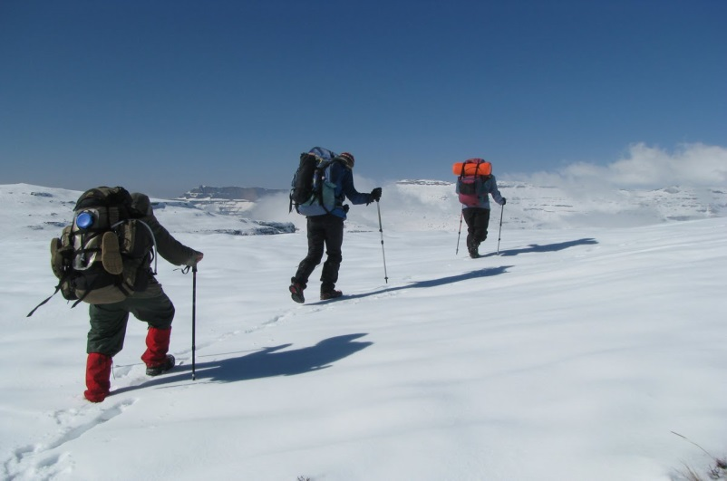
Demographics
Seek bonding
-Enjoyable, safe, outdoor experience
The Family
2.8 million tourists / year, average party size 4.1
Government of Mammoth Lakes, CA Factsheet

Slide 13
Our Proposal

Slide 14
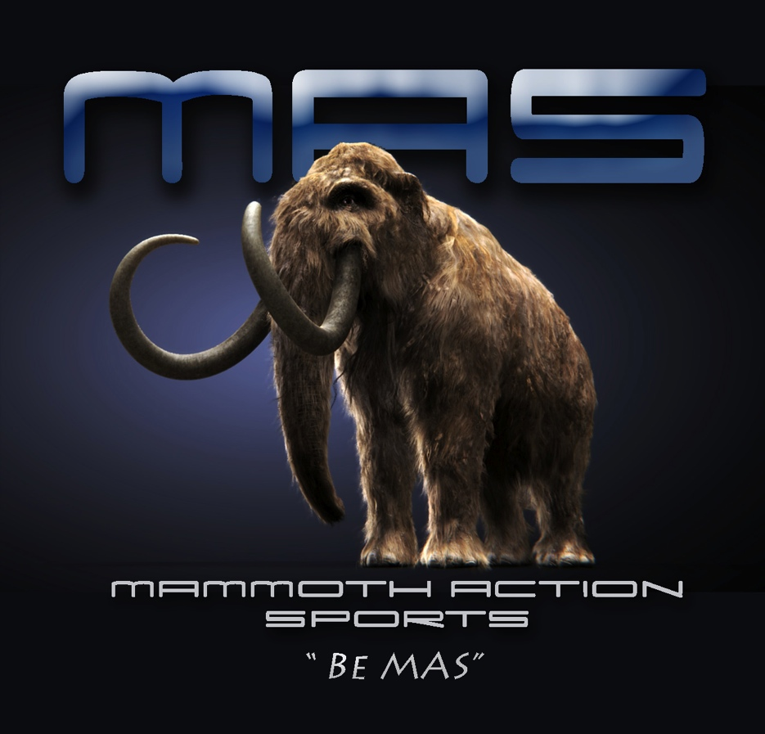

Slide 15

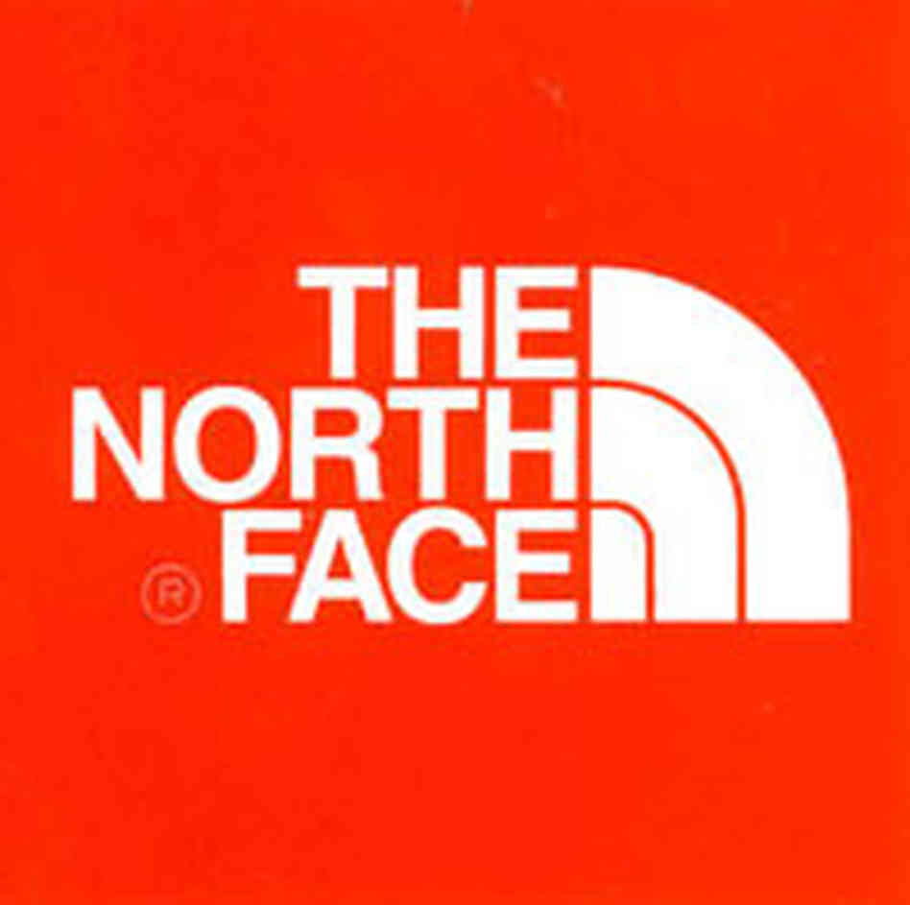
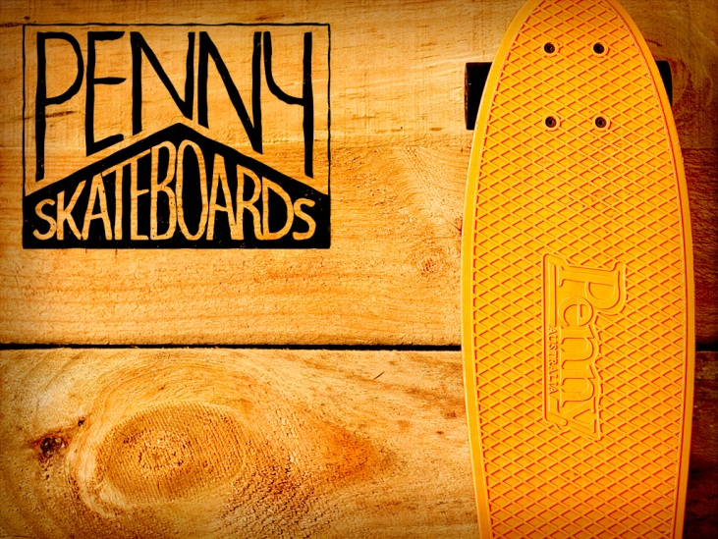
Winter Apparel
Summer Apparel
High quality
Jackets
Snow Pants
Boots
Shirts
Skis
Ski Accessories
Snowboards
Snowboard Accessories
High Quality
Lightweight Jackets
Heat gear clothing
Skateboards

Slide 16
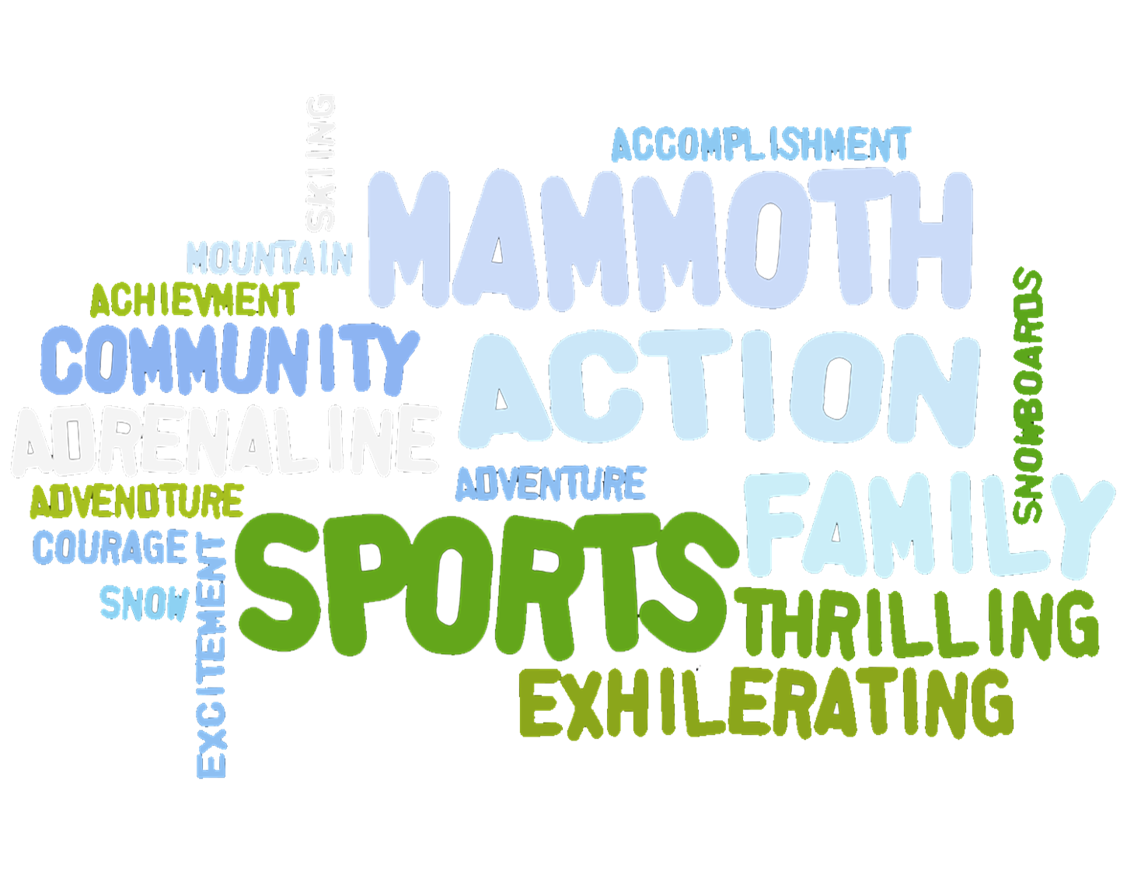

Slide 17

Notes:
Our mission at Mammoth Action Sports is to elevate the action sports community by providing high quality gear, experienced staff, and prices for every budget.
Whether you’ve conquered Everest or are standing in the foothills, we have everything you need to take the next step.

Slide 18

Grand Opening

Slide 19
Grand Opening
Local Celebrity
Contest/Giveaway
Food/Music
Press Release

Slide 20
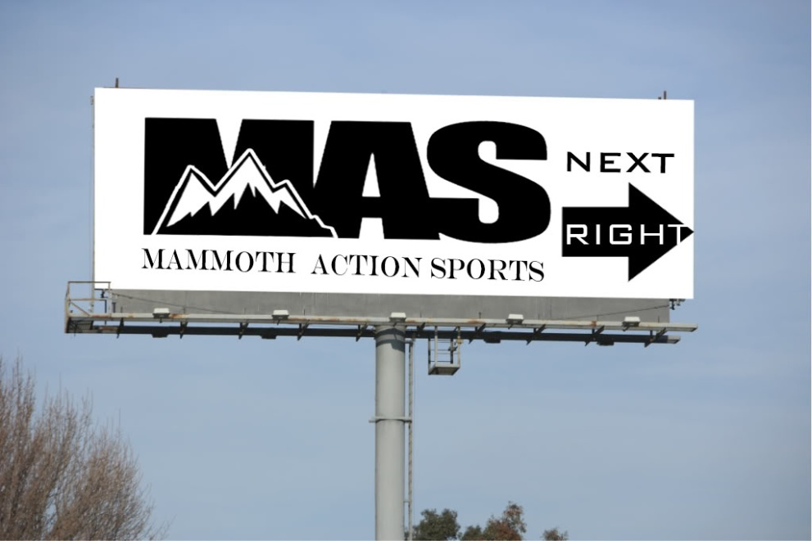
Marketing Strategies
Billboard
4,000+ DEC (Daily Effective Circulation Viewers per day)
Ads in tourism magazines
Internet Advertising

Slide 21
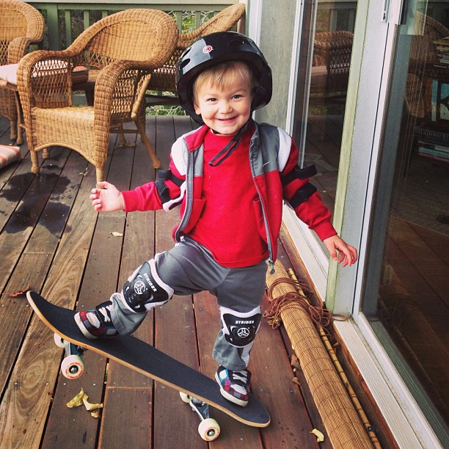
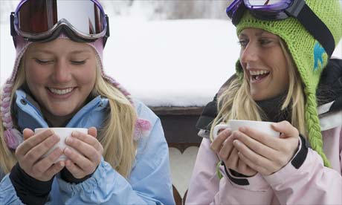
Community Feel
Hot Chocolate
Lounge with couches and TV’s

Slide 22
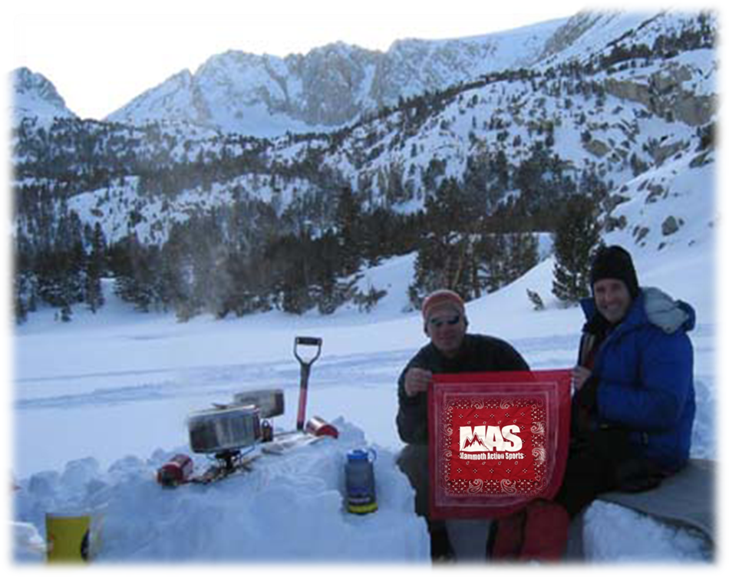
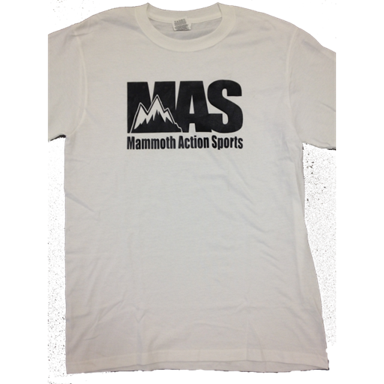
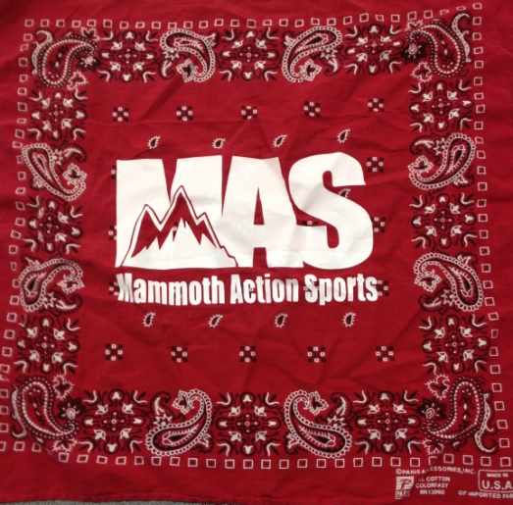
Logo Gear
Will sell promotional t-shirts and bandanas with logo
“Walking Billboards”
“The Wall” will feature customer-submitted pictures with bandana

Slide 23
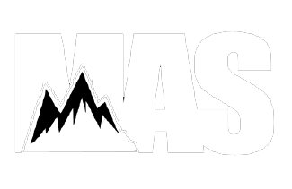
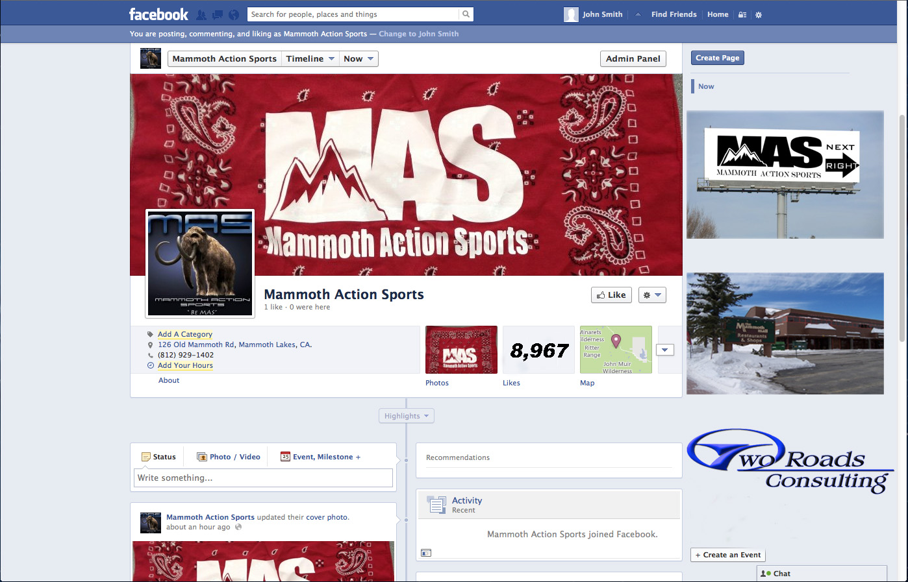



Social Media

Slide 24
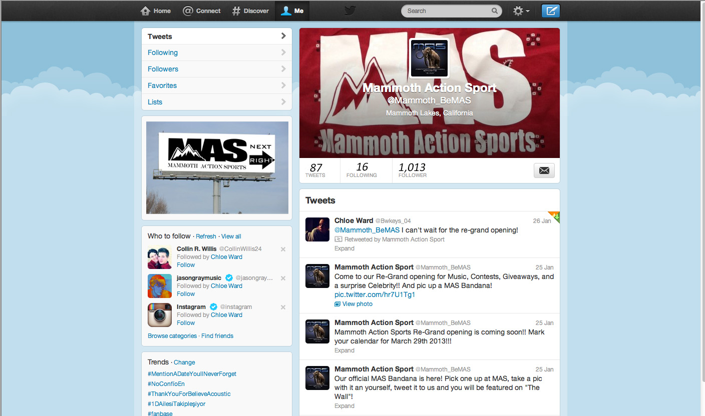

Slide 25

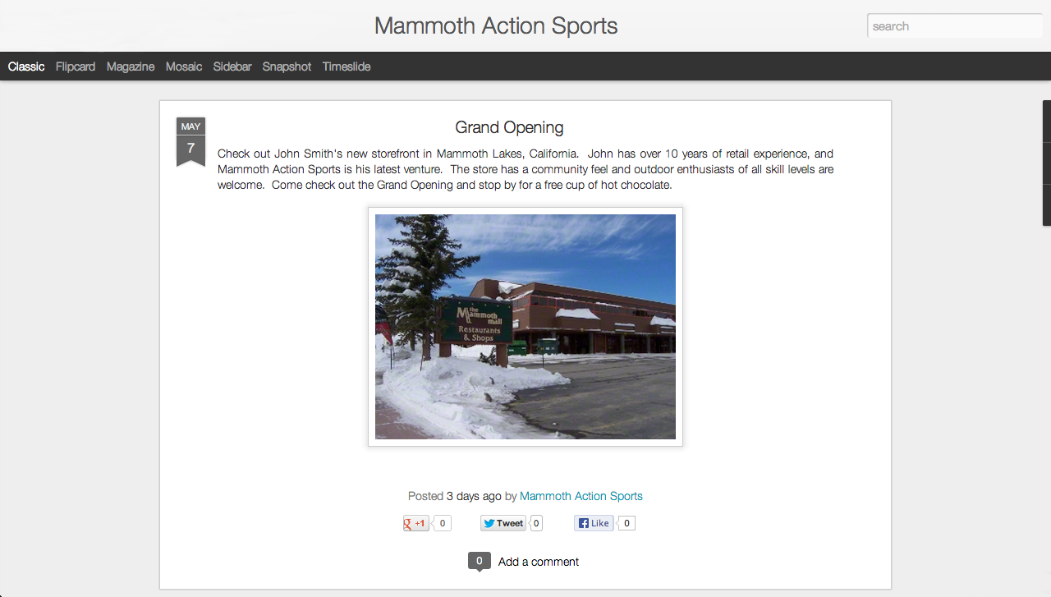

Slide 26
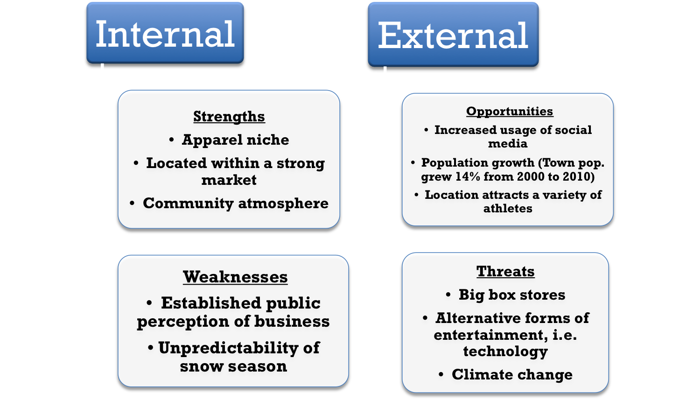
SWOT Analysis

Slide 27

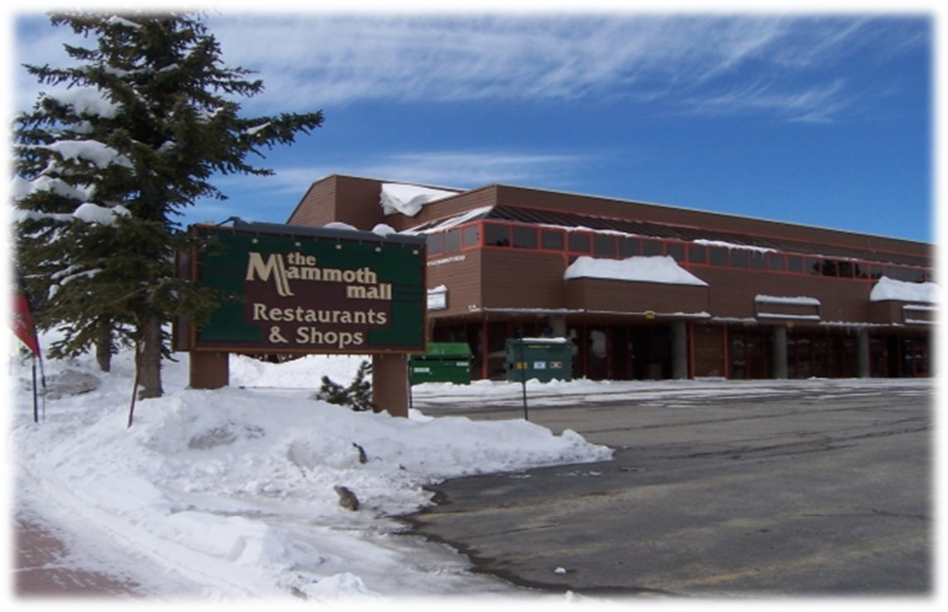


Financial Analysis
Cont.

Slide 28
Additional Investor
Advantages
Disadvantages
More Immediate Capital
Less personal financial risk
Networking
Potential industry expert
Equity
Profit Projected- $490,000 (By year 5)
Giving up $245K for $100K
Decision making power
Majority share
Doesn’t need it

